Slide 1
Module 1 - Creativity
Pauline Belford

Slide 2
Mentimeter quiz
Go to www.menti.com and use this code:
2626 9282

Slide 3
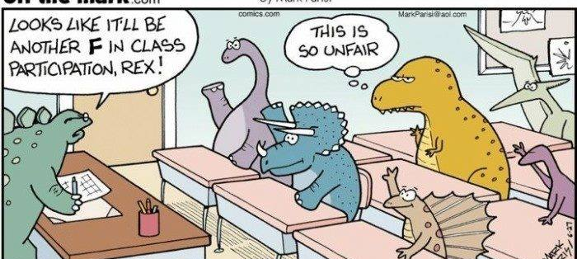
Notes:
If you ask a class full of young children whether they think they are creative, all (or almost all) of them will put their hands up. Young children generally think that they are creative. (I used to want to be an author, and started writing a novel aged 10. It was dreadful. But I thought it was brilliant. A friend happily drew some mediocre pictures for my book.) What happens to us between that moment in our lives and adulthood that changes our perception of our powers of creativity? There is a lot of research into this.
One suggestion is that it’s to do with synapses. Young children have trillions of these. Through a process of synaptic pruning, these decrease over the years.
Kids connect all sorts of unusual things together because they haven’t learned that these things don’t necessarily go together yet. This ability to make connections between seemingly unrelated things is called divergent thinking, and is an important tenet in creative thinking, but it is just one part of it.

Slide 4
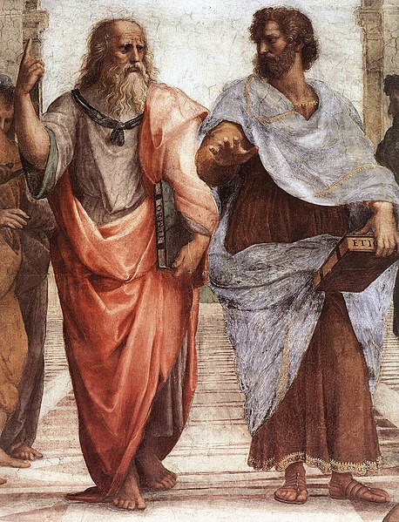
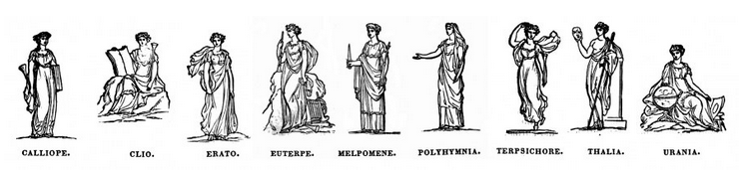
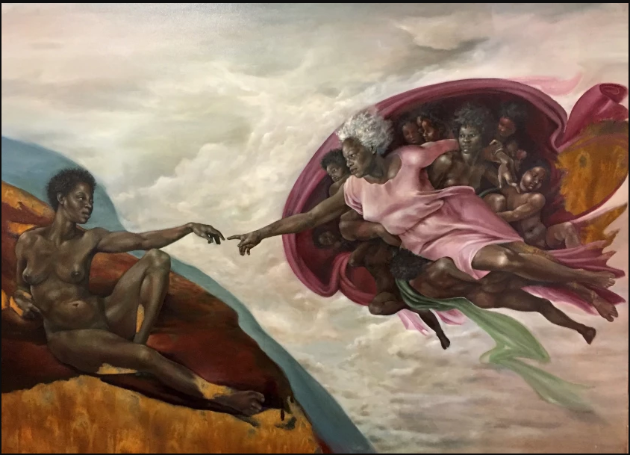
History of creativity
Notes:
Greek philosophers such as Plato rejected completely the idea of creativity. Preferred to see art as a form of discovery. A painter does not make something – he merely imitates. There was no way to be creative, because we just take in input and imitate what we see.
At the same time, the Greeks had the Muses as an integral part of Greek philosophy. The Muses each had different types of art and science which they would inspire. It was seen as coming from the Gods. “Divine inspiration” Creativity was not a characteristic of a human being. It was something that would come from the heavens.

Slide 5
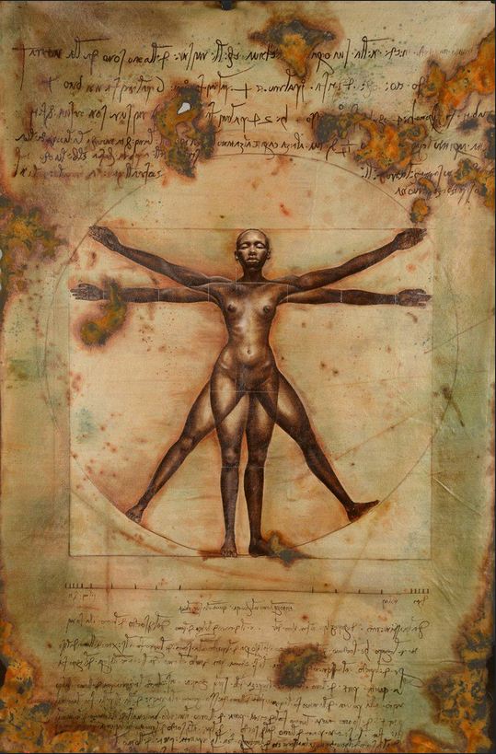
History of creativity
Notes:
Here is a piece of art where Leonardo Da Vinci’s classic male has been replaced by something else. Harmonia Rosales, 2017. The Virtuous Woman.
What is interesting about this piece of art is that it takes something that already exists and reworks it. It adds a different perspective.
This sort of goes together with how Plato would see it. But how did this idea come to her?
It was after the Renaissance that creativity came to be seen as a human ability. It was usually seen as the ability of great men.
For example, Leonardo Da Vinci is the archetypal renaissance man. He was seen as this master creator, and that type of characteristic was exclusive to people of higher education. Creativity was seen as something that was clearly related to greatness.

Slide 6
What is creativity?
“Genius is 1% inspiration and 99% perspiration”
Thomas Alva Edison
“The problem is never how to get new, innovative thoughts into your mind, but how to get old ones out.”
Dee Hock
Notes:
We have changed our minds a little bit on what creativity is since the renaissance.
The first quote is attributed to Edison, but it is not known for sure whether it was actually him who said this.
Creativity and genius really relies on knowing that you need to commit and to work hard, possibly for many months or even years, for things to become creative.
For an example of the crafting process of writing novels, I highly recommend On Writing by Stephen King.
One thing to keep in mind for the rest of this course is that the problem for you to get these new ideas connected to the technologies that you are going to be working with is not how to get new and innovative thoughts into your mind, but how to get the old ones out. This is the difficult part, and it’s not always perceived that way. But every time you come up with something you think is a new thing, try to check if it’s not just an old idea that maybe you need to purge out of your head, a previous understanding that you have? Have you been able to look at things with fresh eyes?

Slide 7

Myths of creativity (Burkus 2014)
Eureka Myth
Creative insights happen in a flash.
Notes:
On that note, there is a little book called The Myths of Creativity. I’m not going to talk about all of them, but I think that there are some that may feel familiar to you, that I think are sort of like a popular culture thing, and that have sort of become embedded in our understanding of creativity.
One of them is called the Eureka myth. This is a very common myth. But it is a myth. If anything, the creative process requires a period of incubation, where ideas and relevant knowledge need to linger in your subconscious for a while. They connect suddenly, you get this sudden realisation, and it looks like it happens in a flash. But, more often, the right connection actually takes some work after this type of incubation. It’s not the case that ideas just come from nowhere.
A friend worked for a company which did the kind of Dragon’s Den thing: took people’s great ideas for physical products which could be engineered, and helped them bring those to market. One guy told the story of how he woke up one night with an idea for a piece of child safety equipment which he immediately then took to this company. He wasn’t an engineer by trade. He didn’t have a degree in a related (or any) subject. But he had spent several months thinking about this problem. That moment when he woke up was just when everything coalesced and he found his solution. This story isn’t just about the eureka myth. It also debunks the idea that only “great men” can be creative, and provides a little evidence for the idea that a fresh perspective is useful in ignoring (or not knowing about) the old ideas in order to discover better new ones.

Slide 8

Myths of creativity (Burkus 2014)
Breed Myth
Creative individuals are a certain type or breed.
Notes:
This myth is influenced from the renaissance perspective. Creative individuals are of a certain type or breed. But there is no evidence whatsoever supporting the idea of a creative gene or creative personality type. There is a wealth of evidence showing that creative potential exists inside of everybody. It is not related, in any way, to any kind of pre-determined package. So don’t worry if you think your parents and/ or other family members are really uncreative.

Slide 9


Myths of creativity (Burkus 2014)
Originality Myth
Creative ideas are or need to be wholly original concepts.
Notes:
As we have already touched upon, all ideas are new combinations of older ideas. The novelty comes from the combination of the ideas or the application, not from the idea itself. It’s about finding the right combination of ideas that already exist.
For example, fleece is a solution to the problem of cheaply insulating things – or people. The materials for making it (recycled plastics) already existed. The way in which the fibres of these are layered together came from penguin feathers. Penguins have layers of overlapping feathers, which trap heat and provide protection from wind. By examining this structure and reproducing it with the plastic threads of fleece, a lightweight, windproof and very warm product was created. There was nothing new, but it involved combining knowledge from different subject areas, and applying it to another new area.

Slide 10
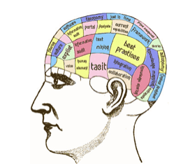
Myths of creativity (Burkus 2014)
Expert myth
Innovative solutions are only found by highly trained experts.
Notes:
This one is interesting. It tends to result from the fact that people don’t talk so much with some other people outside of their field of expertise.
This is not always the case. Of course, some basic level of expertise/ knowledge matters. But the most innovative solutions often come from those on the fringes of the subject area. Those who know enough to understand the area, but not enough to block their creative thinking.
Very often, when you know too much about something, you will also likely not be the most creative person in that domain.

Slide 11

Myths of creativity (Burkus 2014)
Lone creator myth
Great creative work happens in isolation, a lone individual slaving away at a problem.
Notes:
As a society, we do have this idea of the artist or auteur, hidden away in their room for months, finally emerging with their new masterpiece or invention.
Actually, the majority of innovations come from teams, and were formed because they had the right network of collaborators.
A somewhat old example: The Beatles. John Lennon and Paul McCartney produced their best work when they worked together. They brought out the best in each other. Lennon’s solo work wasn’t as good, and McCartney’s is – definitely inferior to his collaborative works.

Slide 12
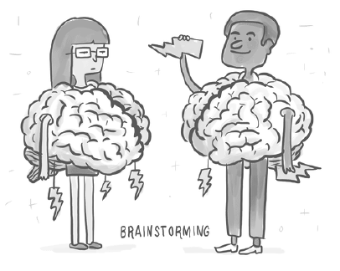
Myths of creativity (Burkus 2014)
Brainstorming myth
Creativity requires brainstorming to find great ideas.
Notes:
Brainstorming is a great tool. But actually the creative process requires several stages and various methods, and it really doesn’t require you necessarily to do these formalised brainstorming methods or sessions.

Slide 13

Myths of creativity (Burkus 2014)
Cohesive myth
The best creative teams are completely cohesive
Notes:
There is this understanding sometimes that the best creative teams are completely cohesive, so they have an even distribution of people and that they are a very easy to identify group. But actually, outstandingly creative teams tend to utilise structured conflict and dissent to find ideas. It is through conflict, and being able to disagree with others, that the best ideas can arise.
A people hire other A people. B people hire C people who agree with them and don’t challenge them. The best thing you can do to help sharpen and test your own ideas is to being in regular communication with smart people who disagree with you, and/ or whose skills or strengths complement your own.

Slide 14
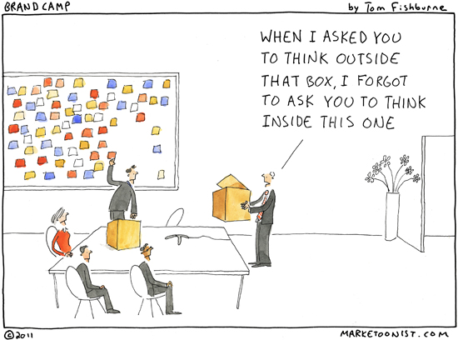
Myths of creativity (Burkus 2014)
Constraints myth
Creativity is highest when totally free and unbounded.
Notes:
This is Mafalda’s favourite myth. Found a lot in students. This belief is a big mistake. Creativity loves constraints. The fact that you are given a frame to work within makes sure that you don’t get lost in a bunch of details.
So, if you are feeling like “Oh, I have all these things that I have to constrain myself to. This feels like such a difficult problem because of all of these constraints.”, be aware that it is actually those factors that help to support you in identifying great ideas.
The Paradox of Choice. Barry Schwarz. This book was about how we can’t cope with too much choice. If there are 3 types of pasta sauce to choose between, we can make that decision easily. If there are 25, we get overwhelmed and tend to automatically reach for our usual brand without considering the others. If you have completely free reign then you can end up being overwhelmed by the possibility space, or going down lots of completely unsuitable paths and never get anywhere near the right solution space.

Slide 15
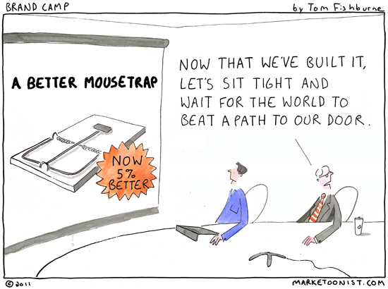
Myths of creativity (Burkus 2014)
Mousetrap myth
If you have a great idea (“build a better mousetrap”) the world will readily accept it.
Notes:
95% of new products fail, only 5% succeed.
Most great ideas are rejected at first. It is because they are new, and either people don’t understand the idea or product, or don’t see the need for it. (Our current mousetrap works well enough.)
If an idea is getting rejected at first, it’s not necessarily a bad thing. Your idea might just be a little too far ahead of it’s time. (Or it could be dreadful, or it is not economically viable to produce or implement.)
A lot of the constraints placed on you in this course are technical ones. You will have constraints that are your own understanding of the tools – what it is possible for you to create using them. Even if you are an expert at using the tools you are going to be constrained by what the tools are capable of.

Slide 16
Other challenges
Fear
Fear is the mind-killer…
Challenge: create a context where one is not afraid
Unrealistic ideas
Solve problems via Deus Ex Machina
Paradox since they may spawn realistic ones
Kill your darlings
Fixating on ideas (my idea!)
Fear of losing the idea
Creativity tasks are often wicked problems
Notes:
Fear will keep you back. We fail ourselves all the time by writing ourselves off and not attempting the thing that is scary.
The challenge for creative thinking is to create this kind of context where you are not afraid. Where you feel free to take steps and fail. You can look at this as, instead of thinking that you will fail, think about what you might have some success with.
There is quite a big difference between trying to fire an arrow and trying to hit the target. You will almost definitely miss the target, but you will definitely fail if you don’t even try to shoot. You miss 100% of the shots you don’t take.
You should try to find a way to feel safe to have these ideas.
There is a paradox with Deus Ex Machina, which is that thinking up unrealistic ideas can quite often spawn realistic ones. So there has to be a balance between not being afraid of taking unrealistic steps, and being able to identify, out of these unrealistic steps, which ones are the ones that are realistic.
We have a huge tendency to fixate on ideas (usually our own ideas). Killing your darlings is a difficult thing to do. It is usually a little easier when you are working in groups. Groups force you to let go of your darlings.
Wicked problems are problems which are very difficult to define, and usually are only understood after you have one possible solution, This makes it very difficult to know what path to follow.

Slide 17
Other challenges
“To live a creative life we must lose our fear of being wrong”
Joseph Chilton Pearce
Pearce was an American author speaking on child development. He believed that active, imaginative play is the most important of all childhood activities because it cultivates mastery of one’s environment, which he terms “creative competence.”
Notes:
Hopefully in this course you will be able to do things and experiment. You can’t experiment without the possibility of failure.
People who have been successful in business often had several businesses that were failures, before the one that succeeded. There is discussion in the business community about the benefits of failing fast. It’s better to find something isn’t the right idea, so you can learn from the failure and move on quickly to a more promising idea, rather than having something that limps along but is never going to take off in a big way.

Slide 18
What is design
“Finding the right physical components of a physical structure” (Alexander, 1963)
“A goal-directed problem-solving activity” (Archer, 1965)
“Decision making, in the face of uncertainty, with high penalties for error” (Asimow, 1962)
“Simulating what we want to make (or do) before we make (or do) it as many times as may be necessary to feel confident in the final result” (Booker, 1964)
“The conditioning factor for those parts of the product which come into contact with people” (Farr, 1966)
Notes:
You’re going to be designing games, or designing gameplay.
We always bring this up in our design courses. There are many different definitions of what design is.
Alexander is the author who introduced pattern language, so he knew quite a bit about components. He seems to say that design is about components, and that is exactly what you are going to be trying to be doing during this course.
It could be seen as goal-directed problem-solving. There is an issue here in that goals are sometimes difficult to define.
Asimow’s definition applies very well from an architectural or civil engineering perspective. The cost (both financial and potentially in human lives) for error if your building or bridge is poorly designed can be enormous. Fixing errors can be a lengthy and costly process that will impact a lot of people. The penalty for error is very difficult to tackle. When designing an AR app, you generally don’t face the same kind of penalties.

Slide 19
What is design
“Engineering design is the use of scientific principles, technical information and imagination in the definition of a mechanical structure, machine or system to perform prespecified functions with the maximum economy and efficiency” (Fielden, 1963)
“Relating product with situation to give satisfaction” (Gregory, 1966)
“The performing of a very complicated act of faith” (Jones, 1966)
“The optimum solution to the sum of the true needs of a particular set of circumstances” (Matchett, 1968)
“The imaginative jump from present facts to future possibilities” (Page, 1966)
“A creative activity – it involves bringing into being something new and useful that has not existed previously” (Reswick, 1965)
Notes:
Fielden’s definition takes in a lot of factors that contribute to design. You can see that most design projects would have most of these factors.
Gregory’s definition brings in the users. There is no point in designing something that does not take into account what the users actually want or need. (Of course, getting specifics from the user can be a very difficult process, but that is a different issue.)
Jones – you have to believe in the thing you are designing.

Slide 20
What is design
Many different stances towards design and creativity are possible.
So: every one (it depends)
In this course we will:
Look at bounded creativity
Use a systematic method for ideation
A limited part of creativity and design.
But perhaps aligns to all views presented earlier?
Notes:
There are a lot of different stances on what design and creativity is.
It depends on who you are asking.
Creativity with constraints. We only have one week to focus on this.

Slide 21
Wicked problems (Rittel & Webber, 1973)
Characteristics
Not understood until after solutions are found
Have no stopping rule
Solutions are not right or wrong
Every problem is essentially novel and unique
Solutions have no given alternatives
How to mitigate wicked problems?
Language to discuss aspects or parts of the problem
Methods
Notes:
You are going to find this in the projects that you are going to be doing. If you don’t know when to stop, if you have no tools to discuss these kind of issues, then you are going to have a hard time.
Language: This is why Staffan’s library of gameplay design patterns is very useful, because it gives a standard language for us to discuss what you are doing in the gameplay.
Methods give you a recipe for things that you can do. Cooking is creative, but it is also something where you can follow recipes, then deviate from them until you create your own preferred version of them.
You have unlimited possibilities with cooking. But just imagine that you would be cooking with all of these ingredients without knowing what they are. You probably wouldn’t have a great result. Maybe something like the food mixtures they get contestants to identify in a few Taskmaster/ Bäst i Test tasks. Therefore it is much better for you to first identify what you have. (Milk, pasta, cheese, etc.) Then you try to find combinations of the items that will work well together. You will not know if the thing will be tasty or not until you cook it. Cooking can be a good example of a wicked problem.
You look at a set of ingredients that you have and if you use a recipe you know that your result will probably be better than if you just cook something random.

Slide 22
What is a design method
“Simply put, a method refers to a description of a way of working or a recipe of action. A method is always based on a specific purpose and specific values, and it translates them into an actable procedure.”
(Löwgren & Stolterman, 2004)
Brainstorm, interview, sketching, consult a colleague.
Notes:
You usually have a goal. A method should be a procedure, a number of steps. You probably know all of these methods already.
Baking is quite a tough task. Cooking is the humanities of sciences whilst baking is the actual hard science. If you get it wrong, you will know. But it is easier if you follow the recipe. Cooking is more creative than baking.

Slide 23
Interaction relabelling or random links
Steps in random links:
Pick a random item (or even better, have someone else bring you a random item or select one for you)
Write down all of the attributes and associations you can think of
Force a connection to the product you are working on
https://www.randomlists.com/things
Notes:
Random links is fun method. We’re going to be using it in a very particular context.
Work in pairs. Each pick one random thing.
For each random thing, list what characteristics it has.
For example, a mug. A mug is hard, cold (if it is empty or has a cold drink in it). It is probably breakable. What colour is it? What size is it? What shape is it? Look at it and list it’s important characteristics.

Slide 24
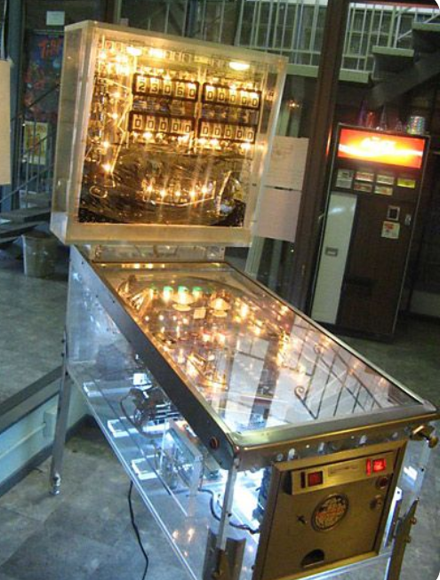
Interaction relabelling random links
With the use of the two objects, design:
A new way to interact with a pinball machine
(some of the elements of a pinball machine include: playfield, plunger, flippers, bumpers, kickers and slingshots, targets, holes and saucers, spinners and rollovers, switches, gates, stoppers, ramps, etc)
Notes:
What happens if an existing element of the pinball machine is changed in some way? Or a new element is added?
Write your ideas on the mentimeter.
This method is better applied when you have managed to come to an abstraction level about your objects that results in simpler ideas. You don’t need to use the objects directly in or with the pinball machine. Try to abstract the essential components of these objects and see if you can find more abstract level connections.

Slide 25
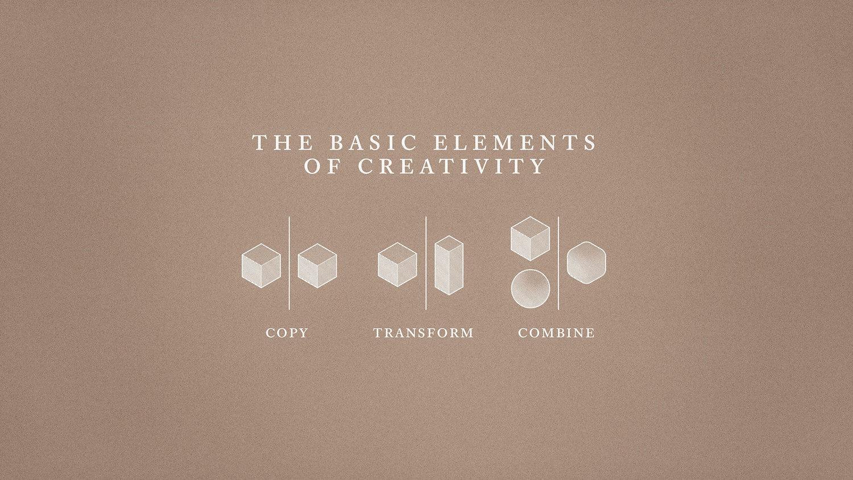
https://www.everythingisaremix.info
Notes:
Tries to come up with smart ways of showing that creativity is actually a stack of basic elements. Usually what you do when you create new things is that you are either copying, transforming, or combining them. Or a mixture of these. This video has a number of useful examples of this.

Slide 26

Ideation methods
Basically… There are 5 categories of ideation methods
Rearrange pieces
Remove pieces
Add new pieces
Change Users
Change Context
Notes:
What I think is very important to take out of the Everything is a Remix video is that basically there are 5 different categories of ideation methods.
The film showed you a set of examples where all of these things are done. Most of them however, quite interestingly, such as the example with the mouse, are about removing pieces. Very often, this is the most difficult operation to do. It is the one that simplifies things, and that makes metaphors clearer.
You should try to remember to always check for the operation of removing as a type of action that you can take.
The method that you are going to be working with in this module is very much based on these ideas.

Slide 27
The problem as given
Purge the obvious solution
Making the strange familiar
Problem as understood
Evocative questions
(Jones, 1992)
Notes:
Jones here talks about some steps that you can take to come up with some new ideas.
In these modules you will be given a problem, and a set of technologies that you have to use. After that, you should try to go through a process of purging the obvious solutions.
Evocative questions help to develop and transform the solutions.

Slide 28
A technique for getting ideas: James Wood Young (1942)
What is most valuable to know is not where to look for a particular idea, but how to train the mind in the method by which ideas are produced…
Gather raw materials
Digest the raw materials “jigsaw puzzle style”
Incubate, let the unconscious do the work while you do something else
Eureka – The birth of the idea
Shaping and development of the idea. Submit it to criticism out in reality …AND learn methods for how to produce ideas!
Notes:
Getting ideas in general can be helped by the use of techniques. What is most valuable to know is not where to look for a particular idea, but how to train your mind in the methods by which ideas are produced.
The random links that you just tried is one of those methods, where you can train to more easily and rapidly identify characteristics in objects that you can combine with other things. This is something that is very trainable. You can start to have mental processes where you look through specific characteristics of the objects. How you can interact with them, what kind of material they are made from, what is the timeline for them? These techniques help you gather raw materials, and then they help you to digest these raw materials like a jigsaw puzzle. Then, after you incubate them, hopefully you have this eureka moment.
Very clear steps of how you can generate ideas.
This is quite an old way of working which has been tried and tested for decades.

Slide 29
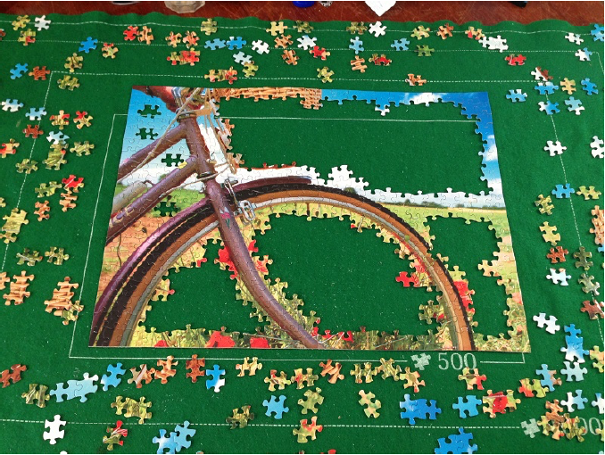
A technique for getting ideas: James Wood Young (1942)
An idea is nothing more nor less than a new combination of old elements
The ability to make new combinations is heightened by an ability to see new relationships.
Notes:
This is a clear example of when we use methods without even thinking about it. This is how you can solve a jigsaw puzzle.
Usually people will start by the corners, and then try to find identifiable bits of the image, because then you can put the colours together. And then you can fill in the most difficult parts of it.
This is a very common method. Most people solve jigsaw puzzles like this never really thinking that this is a method. If you were to try to solve a jigsaw puzzle by starting in the upper left corner, it would take you much longer, it’s a lot more difficult. So if you want to have a bigger challenge, you can do that instead.
What you do here in the jigsaw puzzle is that you try to take steps from the most easily identifiable things, to enable you to be able to see relationships more clearly. These relationships come in the form of colours, the corners of the jigsaw, the edges of the jigsaw, and so on.

Slide 30

Combinations: New Ideas
Notes:
Who recognises this logo? Does this say anything to you? If you don’t recognise it, does it look familiar in any way?

Slide 31

Notes:
Do you recognise this logo?
Both of these are apps. This is the icon for Pokemon Go.
Pokemon Go essentially builds on another game which is called Ingress. Ingress is s game that had exactly the same components as Pokemon Go. Pokemon Go built on whatever was already built in Ingress. It used the same maps, it used the same stops, it used everything from Ingress, but connected it with a brand. And was therefore a lot more successful.
What made Pokemon Go better, or, at least, more successful than Ingress? There is something very particular about doing this. – combining these two ideas. When you partner with an established and immensely successful company you of course have an easier path to success. This is because you are engaging with people through familiarity.
It is important to recognise that even if you have very brilliant ideas for your games, you have to consider the familiarity and engagement aspect. So, how are you playing with things that are already there? How are you considering the technology that you are working with? How are you taking a step forward that is not too much of a step forward? This is a very fine balance.
So, this is just one example of how things can be transformed into something else.

Slide 32
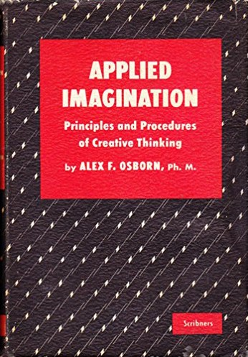
Brainstorming*: Osborn
Defer judgement
Reach for quantity
*Often misused
Notes:
Brainstorming seems to be the go-to method that everybody talks about. Everybody says that they will brainstorm for so many things. It is a method that is very often misused.
Osborn, who invented this term, had essentially two big rules for it.
You should defer judgement. So you should not be judging the ideas at the same time as you are having them. Just write them down.
2. Reach for quantity. Don’t worry about the quality when brainstorming, just try to come up with as many ideas as possible.
Out of all of the ideas you had from the random links it is better for you to have many of them rather than trying to have one concise idea.

Slide 33
Brainstorming: Osborn
Go for Quantity
Prioritise quantity over quality
Withhold Criticism
Critique of ideas is not allowed
Saying “but” or “no” is forbidden
Welcome wild ideas
Combine and improve ideas
Pros?
Cons?
Notes:
Of course, this method has some pros and cons. These are usually discussed in the methodology course.
One of the pros of brainstorming is that it is rather unstructured. It is very accessible to a lot of people. This is at least partly why it’s use became so widespread.
One con being that it is very unstructured and doesn’t have a recipe, which means that it is very often misused. It also tends not to take into consideration the people that are brainstorming. So it would be very easy for somebody with an alpha attitude to take over a brainstorming session – whoever shouts the loudest or is most assertive/ aggressive.

Slide 34
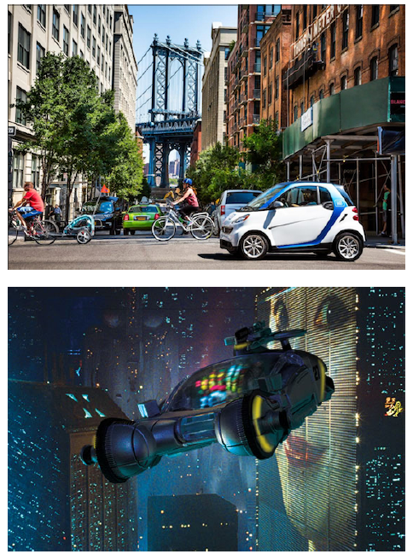
Removing mental blocks: J.C. Jones
State your problem in just one sentence.
“We need to find ways to change how people drive through the city centre.”
Exchange all words for synonyms. Mix and match and see what happens.
We must explore roads to cash how humanity pilot across the metropolis’ midpoint.
Notes:
There are a lot of methods for removing mental blocks. This one is a good one.
State your problem very concisely. Exchange all the words for synonyms. Just changing the way that the sentence is constructed gives two completely different pictures. While the first one reminds me of the top image, the second one makes you think of a much more futuristic vision.
By now you are probably wondering, so what is this method that we are going to be using for this exercise.

Slide 35
A systematic method of creativity
State objective X
Enumerate elements in context (E₁, E₂, etc.)
Go through all permutations possible using the following templates:
Solve X by adding more of E_{y}
Solve X by removing E_{y}
Solve X by skewing E_{y}
Solve X by combining E_{y} and E_{z}
Solve X by creating an imbalance between E_{y} and E_{z}
Notes:
So this is the method. We are using a systematic method of creativity.
Skewing means that you turn it into something else, or that you mould it or that you work with it in some way such that you stretch the concept of E.
Sometimes you end up in situations where these feel quite similar. That is a normal thing to happen. Many people ask what is the difference between step 1 and step 5? Adding more of one element would create an imbalance between it and another element surely? Creating an imbalanced permutation actually relies on you understanding the relationship between two of the elements, so if one of them goes up the other has to go down, and that is in that operation that you might find the new idea.

Slide 36
A similar method: Scamper created by Eberle; see Thinkertoys (Michalko, 1992) for more information
Substitute – components, materials, people
Combine – mix, combine with other assemblies or services, integrate
Adapt – alter, change function, use part of another element
Modify – increase or reduce in scale, change shape, modify attributes (e.g. colour)
Put to another use
Eliminate – remove elements, simplify, reduce to core functionality
Reverse – turn inside out or upside down
Notes:
Here is a similar method, called Scamper. It is actually quite popular.
What you do in this method is quite similar to the systematic method. A disadvantage of this method in comparison is that it doesn’t require you to create a list of elements in the system, so it doesn’t start in the same way. The advantage of this method is that it has some additional interesting operations. This might be a little overkill for this context. We are hoping that the previous method which you are going to be using will be easier for you to use to come up with a wide set of ideas without having to go through all of these.

Slide 37
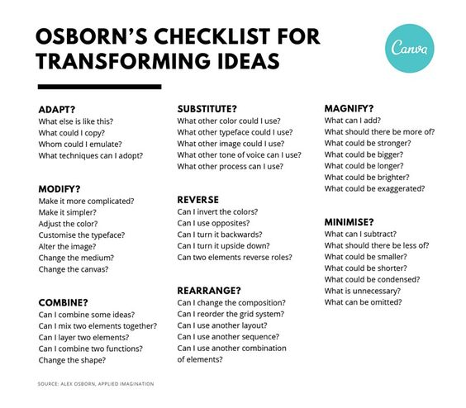
Notes:
If you look through this checklist you can sometimes just find new things by questioning what you have in front of you.

Slide 38
Assignment
Use the creativity method introduced in this module to find experimental or novel gameplay through the use of a digital representation of a physical object.
Choose a real-world object (or many real-world objects) with interesting physical properties.
With your selection(s) you will address three major themes:
What would I do with this object if the laws of physics were not a limitation?
What would I do with this re-imagined object if it then needed to be reintegrated into my environment?
What kind of game could I design around such a thing?

Slide 39
Assignment requirements
The word limit is 3,000 words, excluding references and links. Tables, images, drawing etc. are encouraged. The document should contain the following:
A description of how you used the process
One-line descriptions of at least 10 ideas you generated using the method (these do not need to be good, but they should differ in gameplay)
Note that while the ideas can be based on any element you pick, they should (also) make good use of the capabilities of physical objects in the world. Otherwise you will not be designing new gameplay based on the item.
More detailed explanations of the 3 ideas you found most interesting, and why you found them more interesting (e.g. is it more fun? Shows better use of the technology?)
Which gameplay patterns can be used to describe the games
Advantages and disadvantages regarding ethical and social issues for the more detailed explanations (consider different groups of players)

